Slide 1
Webscraping and Social Media Scraping Project
08.04.2025
Anna Kędzierska-Głodek (332945)
Stanisław Godlewski (473016)

Slide 2

1. Choice of the website
https://www.arbeitnow.com/
1.1. Reason
public availability
transparency
up-to-date job listings
include requirements, location, work mode and salary ranges
highly valuable for analyzing the job market (in Germany)
useful resource for job seekers

Slide 3
1. Choice of the website
1.2. https://www.arbeitnow.com/robots.txt
User-agent: *
Disallow:
Disallow: /*?__hstc 1.3. https://www.arbeitnow.com/terms
Use License
a. Permission is granted to temporarily download one copy of the materials (information or software) on arbeitnow's website for personal, non-commercial transitory viewing only. This is the grant of a license, not a transfer of title, and under this license you may not:
modify or copy the materials;
use the materials for any commercial purpose, or for any public display (commercial or non-commercial);
attempt to decompile or reverse engineer any software contained on arbeitnow's website;
remove any copyright or other proprietary notations from the materials; or
transfer the materials to another person or "mirror" the materials on any other server.
b. This license shall automatically terminate if you violate any of these restrictions and may be terminated by arbeitnow at any time. Upon terminating your viewing of these materials or upon the termination of this license, you must destroy any downloaded materials in your possession whether in electronic or printed format.

Slide 4
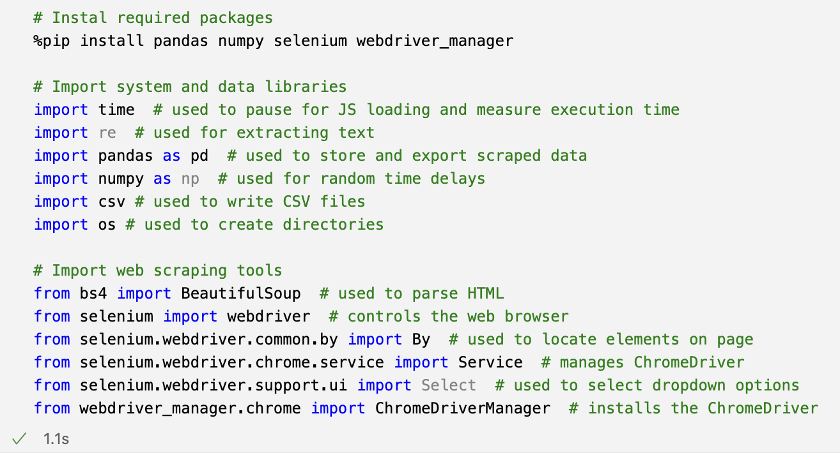
2. Collecting data from the website (07.04.2025) 2.1. InstalL packages, import libraries and tools

Slide 5
Description of Functions
Requests: Used to send HTTP requests to retrieve webpage content easily.
BeautifulSoup4: A library for parsing HTML and XML documents, allowing easy navigation and modification.
Pandas: A powerful data manipulation library useful for organizing scraped data into data frames.
Selenium: Automates web browsers to interact with web pages, ideal for scraping dynamic content.
WebDriver: A component of Selenium that allows control of web browsers via browser-specific drivers.
ChromeDriver: Executables that connect Selenium commands with specific web browsers.

Slide 6
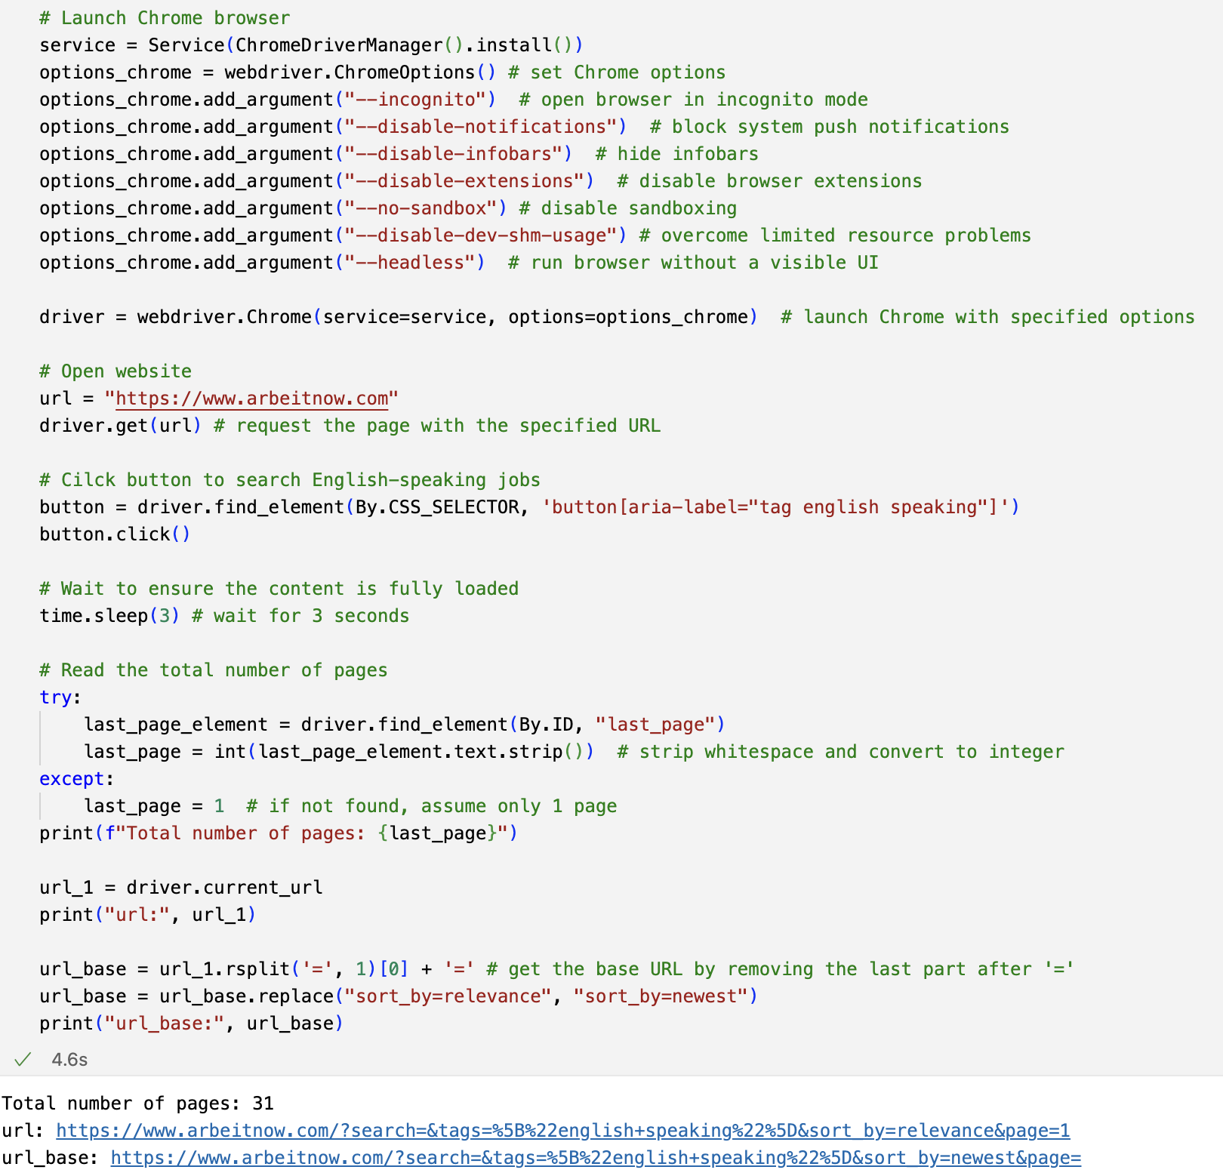
2. Collecting data from the website (07.04.2025) 2.2. Check total number of pages for English-speaking jobs

Slide 7
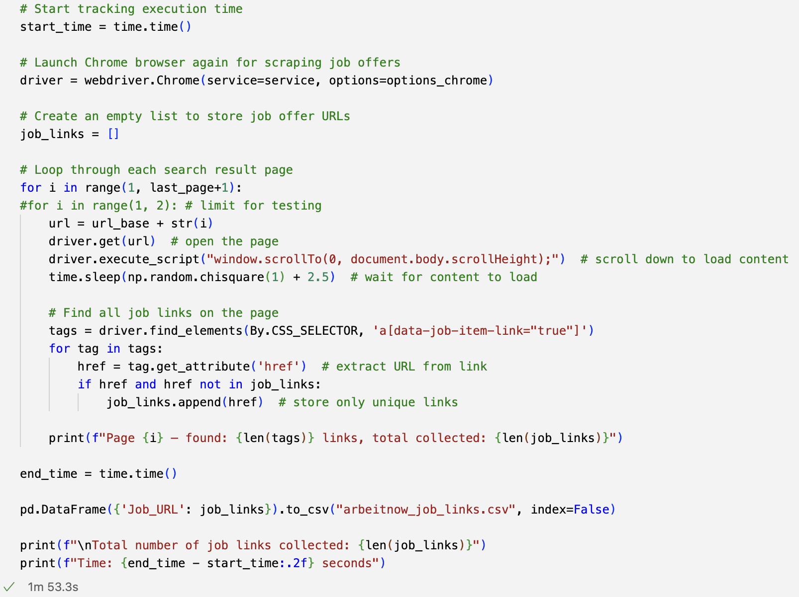
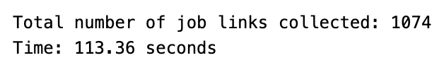
2. Collecting data from the website (07.04.2025) 2.3. Collect links

Slide 8
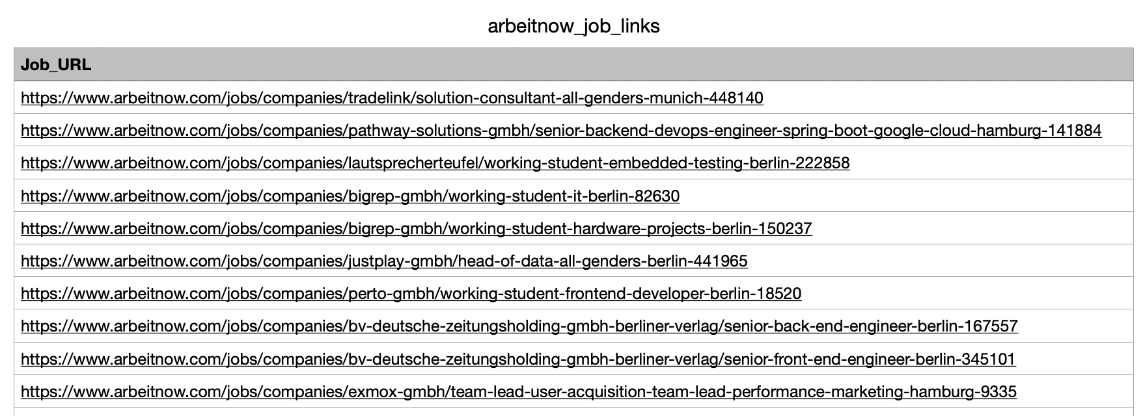
2. Collecting data from the website (07.04.2025) 2.3. Collect links – csv file

Slide 9
Description on Collecting Links
Access the Web Page:
Used the Requests library to access the page containing job postings.
Parse HTML Content:
Utilized BeautifulSoup to analyze the HTML structure of the web page.
Identify Links:
Looked for specific classes or attributes to efficiently find the desired links, such as <a> tags, which commonly hold the hyperlinks to the job postings.
Extract URLs:
Retrieved the hyperlinks from the identified tags and store them in a list using pandas.

Slide 10
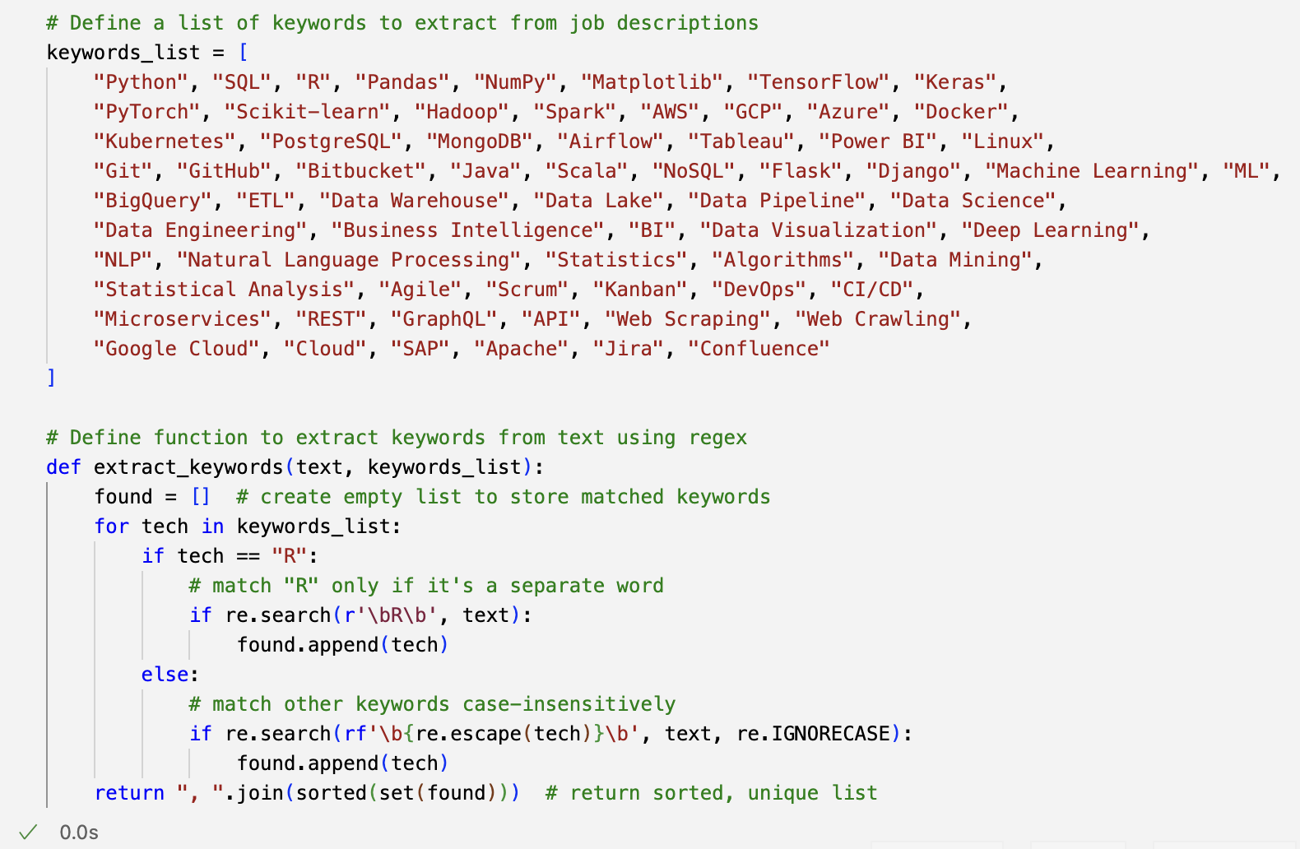
2. Collecting data from the website (07.04.2025) 2.4. Define a list of keywords, AND function to extract keywords from text

Slide 11
Description of Extracting with Keywords
Defined the Keywords List: Made a list of important keywords related to the topic, including job titles and skills needed to find job opportunities.
Function to Extract Keywords: Created a function that looked through the text for the keywords in the list and gathered all the keywords it found for review.
Used the Function: Ran the keyword extraction function on the text taken from the website, which gave a list of keywords that fit the criteria.
Implemented in a Web Scraper: Added the keyword extraction function into the web scraper, so it could automatically check the text pulled from the website.
Returned Results: Made sure the function returned a complete list of found keywords, which helped with further analysis and understanding of the job data.

Slide 12
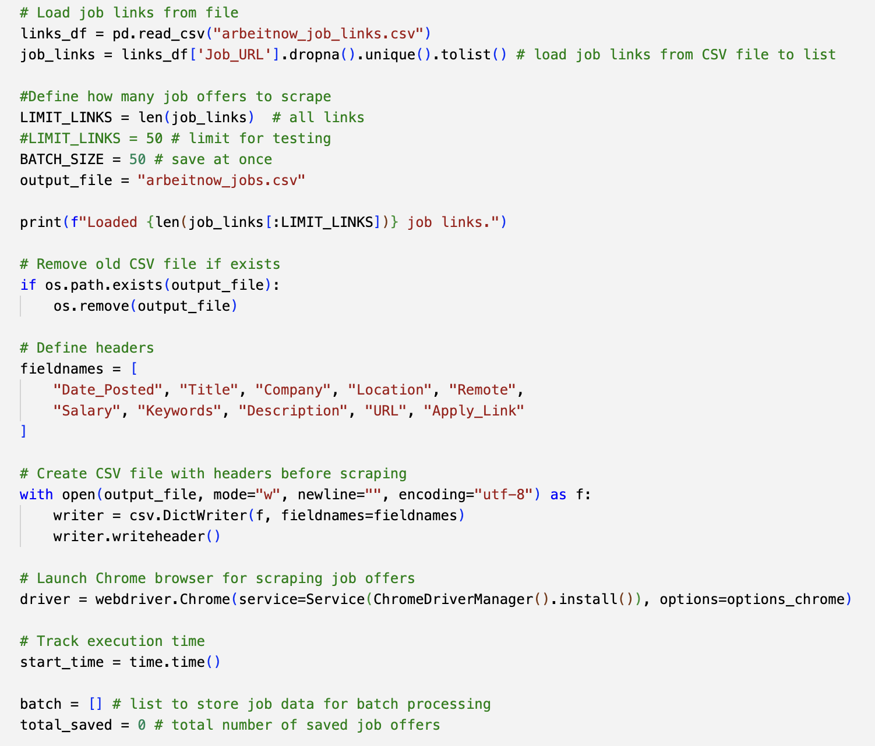
2. Collecting data from the website (07.04.2025) 2.5. Scrape job details 1

Slide 13
Description of Scrap Job Details 1
Identified the Job Listing: Found the specific sections on the website where job details were posted, including job titles, descriptions, and requirements.
Set Up the Scraping Tool: Configured the web scraping tool to access the job listing pages and collect the necessary information.
Extracted Job Information: Ran the scraper to gather job titles, company names, job locations, and descriptions from the listings.
Stored the Data: Saved the collected job details into a dataset with pandas.
Checked Results: Reviewed the scraped data to ensure accuracy and completeness, making adjustments to the scraping process if needed.

Slide 14
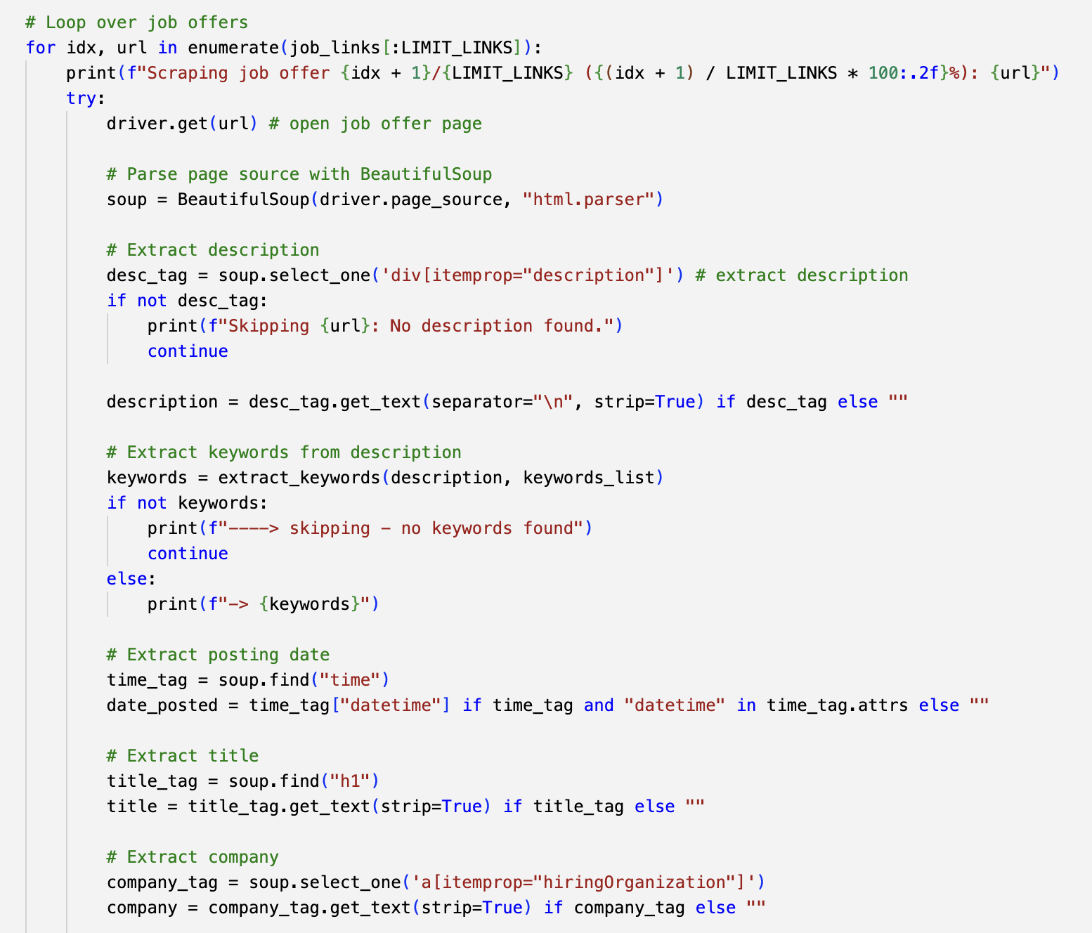
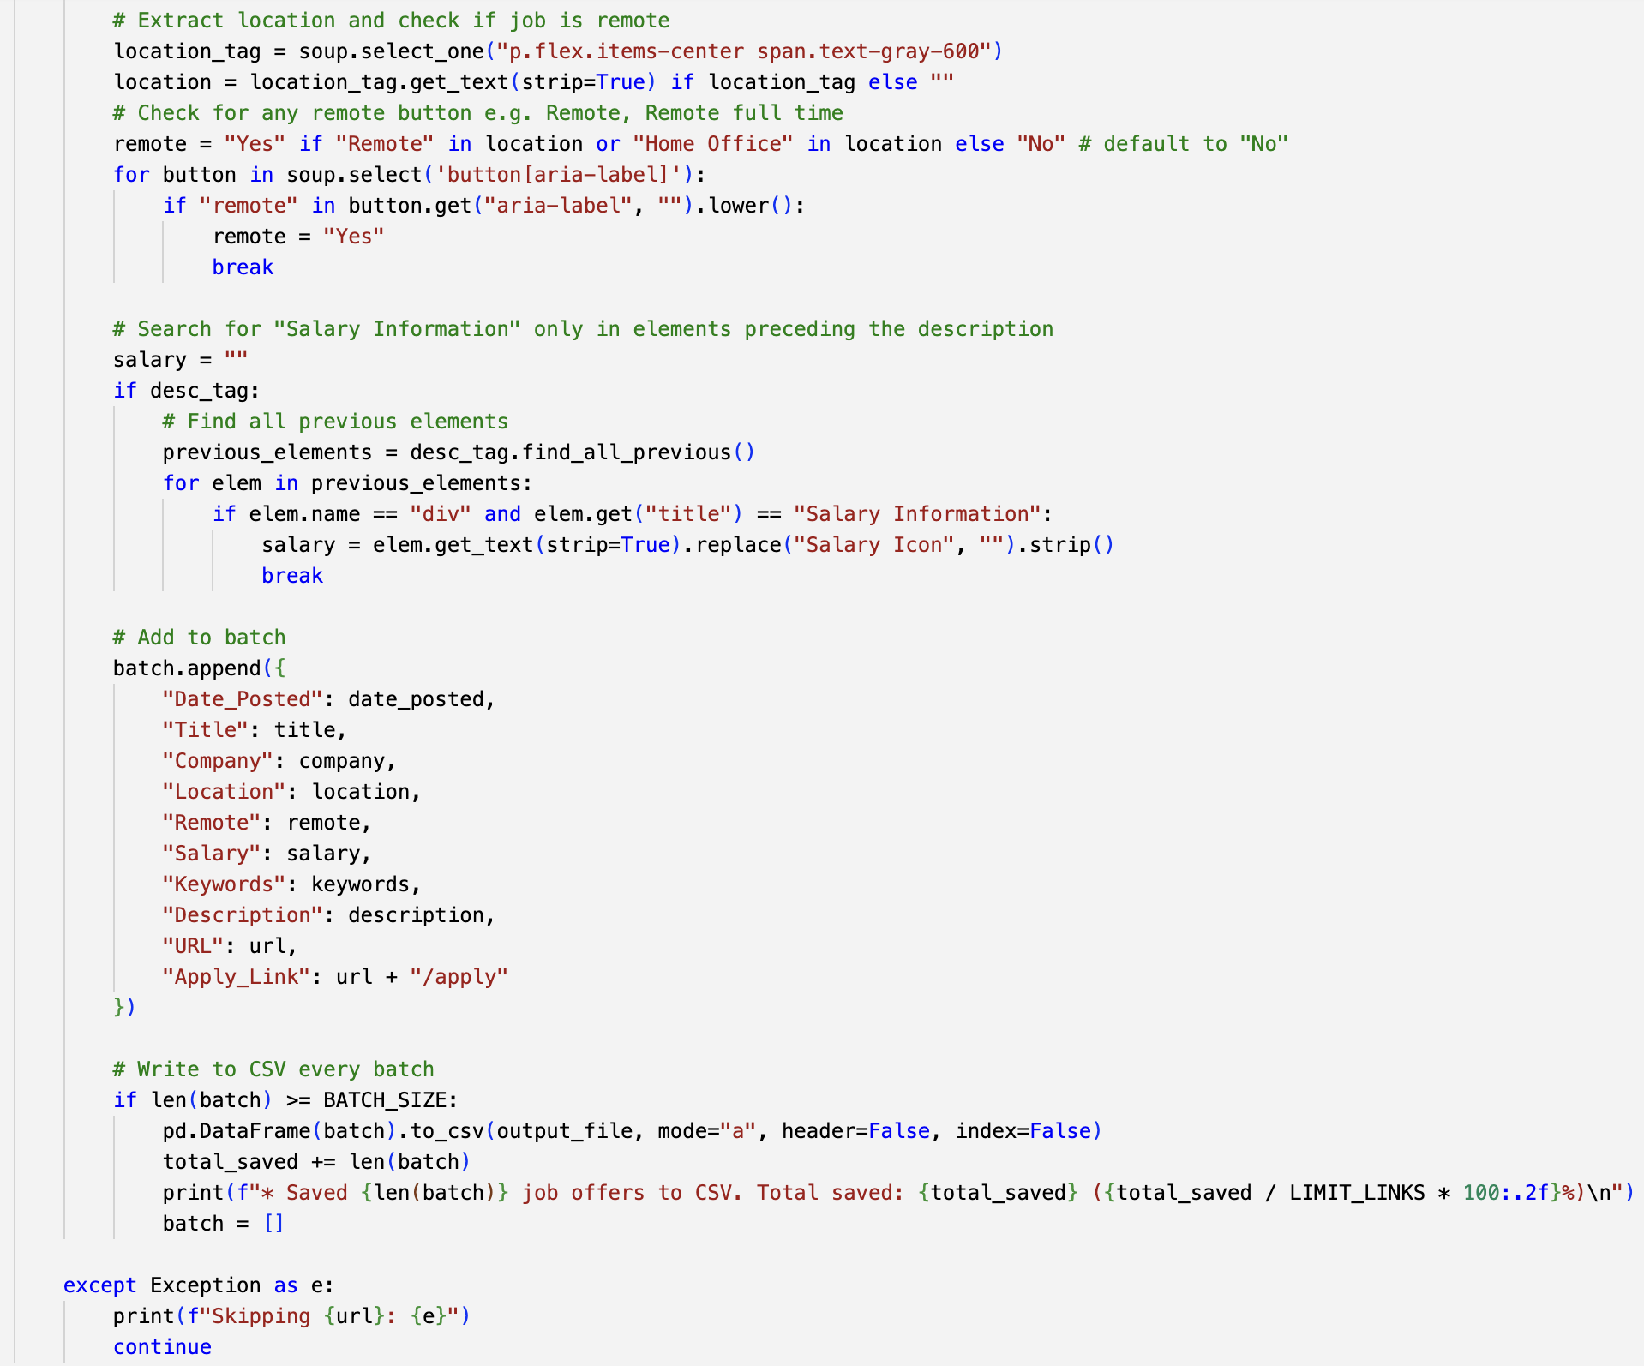
2. Collecting data from the website (07.04.2025) 2.5. Scrape job details 2

Slide 15
Description of Scrap Job Details 2
Focused on Additional Listings: Targeted another set of job listings on the website that featured different roles or categories.
Adapted the Scraping Tool: Adjusted the scraping parameters to ensure the tool accessed these specific sections effectively.
Collected Key Information: Extracted job titles, required skills, application deadlines, and links to the job applications from the new listings.
Organized the Data: Structured the scraped details into the existing dataset while maintaining consistency with the previously collected data.
Validated the Scraped Data: Conducted a review of the extracted data to confirm that it was accurate and correctly formatted.

Slide 16
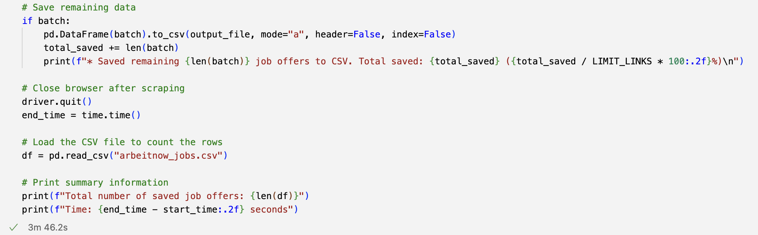
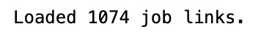
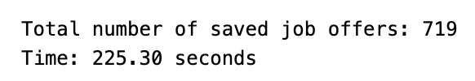
2. Collecting data from the website (07.04.2025) 2.5. Scrape job details 3

Slide 17
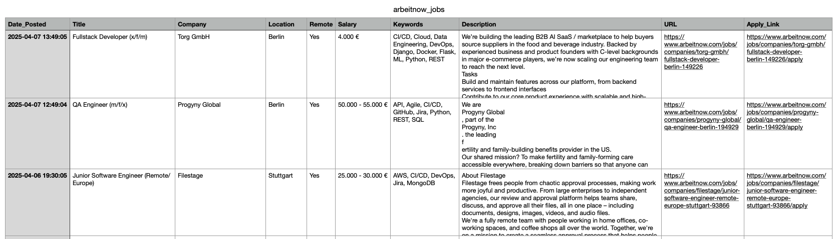
2. Collecting data from the website (07.04.2025) 2.5. Scrape job details 4

Slide 18
Description of Scrap Job Details 3
Explored Final Job Categories: Investigated the last set of job postings available on the website to ensure comprehensive coverage of all relevant roles.
Refined Scraping Approach: Further refined the scraping tool settings to accommodate any variations in the layout or design of this section of job listings.
Extracted Comprehensive Data: Gathered detailed information, which included job descriptions, benefits offered, and employer details, enriching the dataset.
Consolidated Information: Combined the new data with previously collected data to create a unified dataset for analysis.
Performed Quality Check: Reviewed all the information gathered during this phase to ensure no errors were present to make sure that data was ready for analysis.

Slide 19
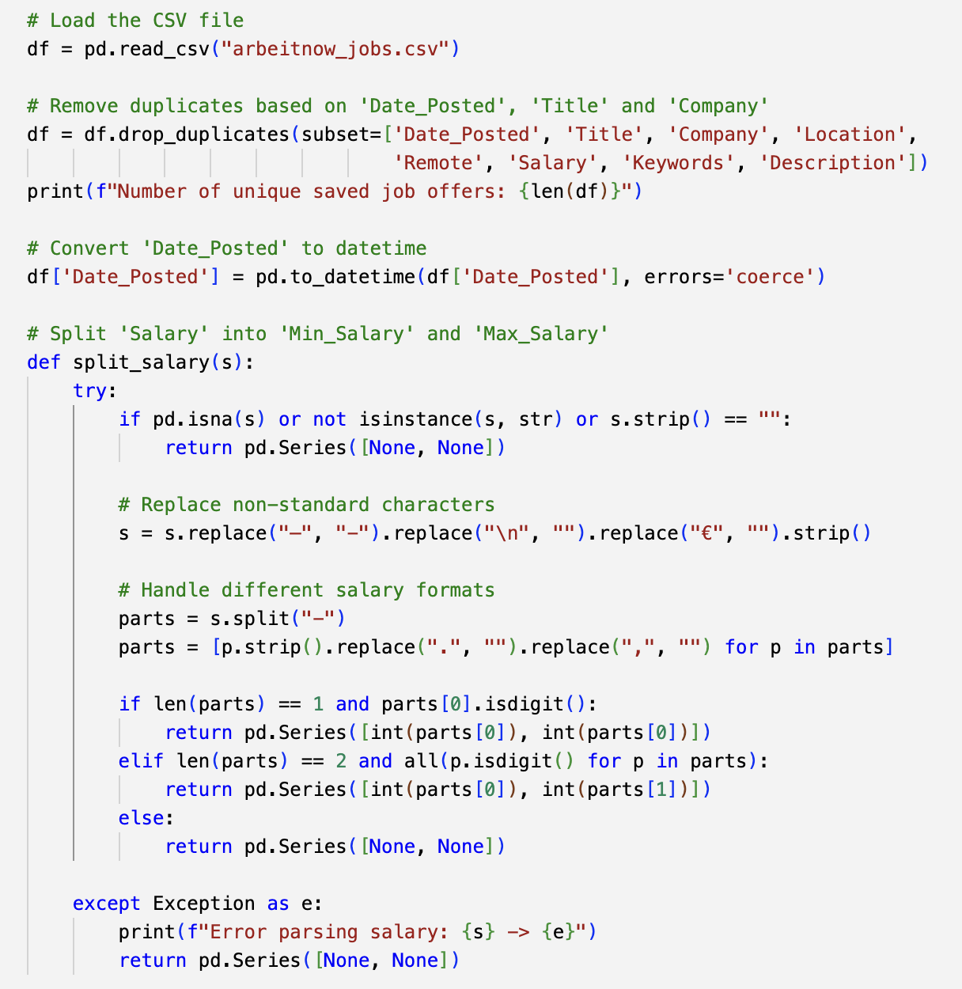
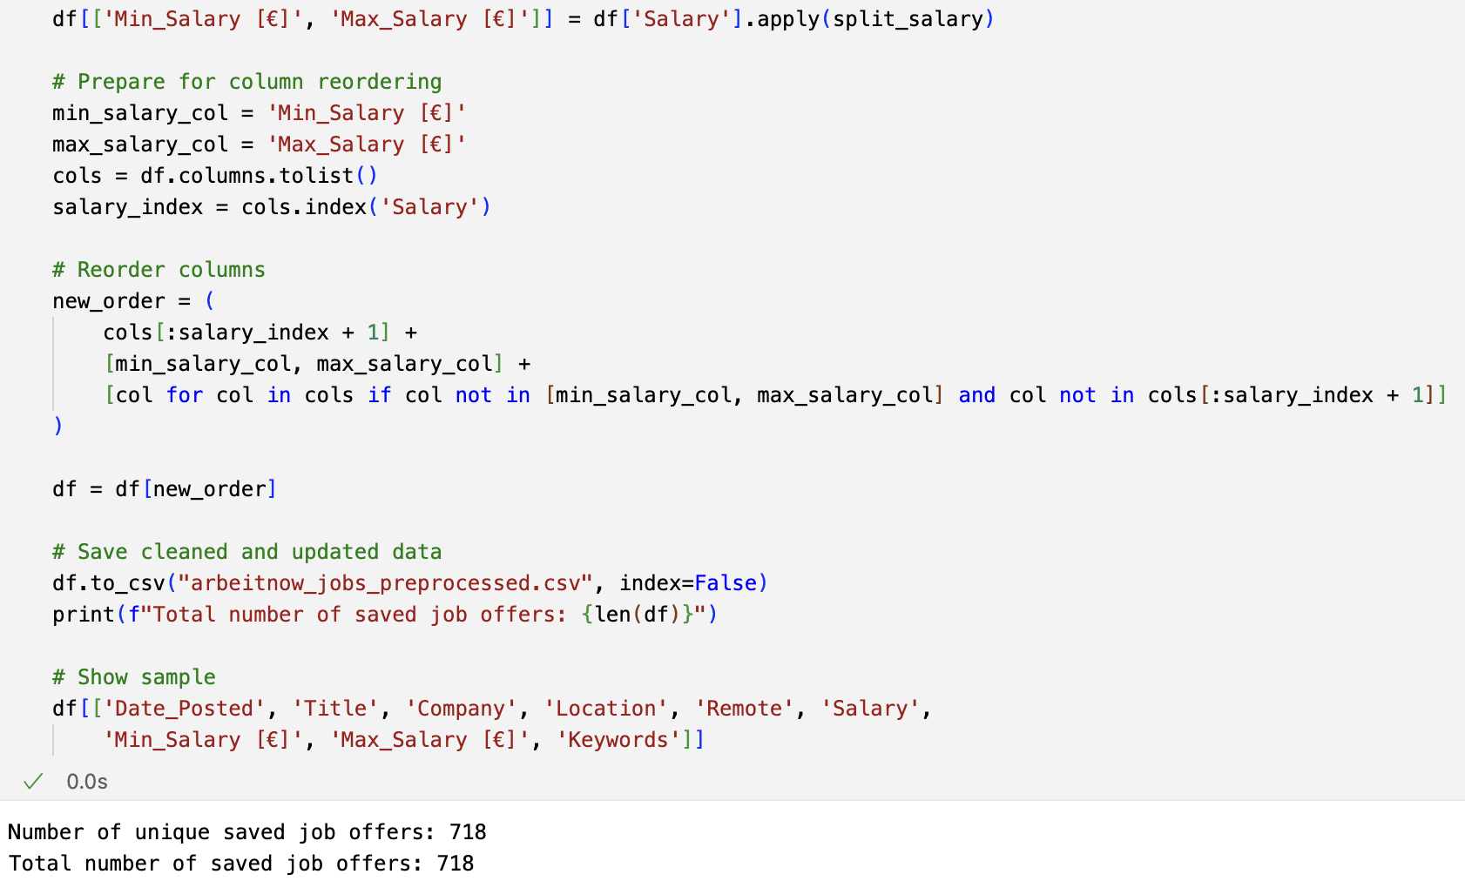
3. Prepare collected data for analysis (07.04.2025)

Slide 20
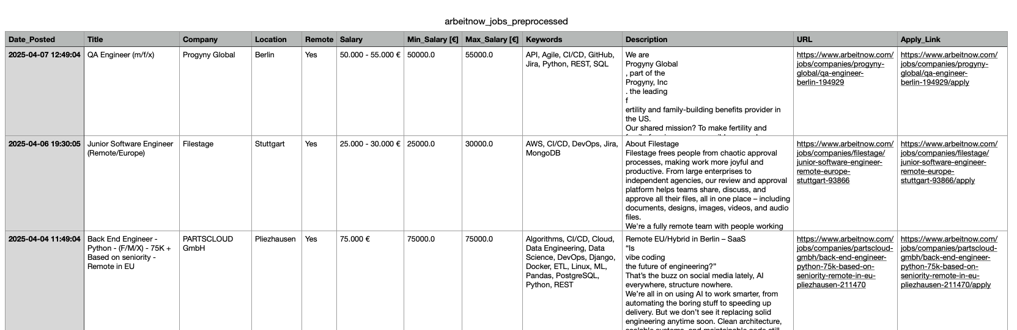
3. Prepare collected data for analysis (07.04.2025)

Slide 21
Description of preparing Data for cleaning
Data Cleaning: Removed duplicates and corrected errors in the dataset to ensure its accuracy.
Data Transformation: Changed data formats and restructured the data layout for better analysis.
Data Exploration: Generated initial statistics and visual representations to understand patterns and trends in the data.
Output Formats: Saved or exported the prepared data to various formats, such as CSV or Excel, for future use or analysis.

Slide 22
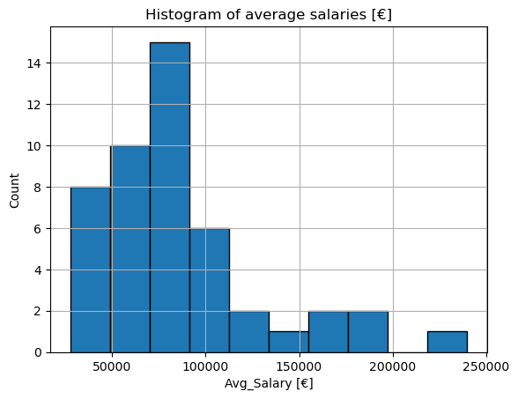
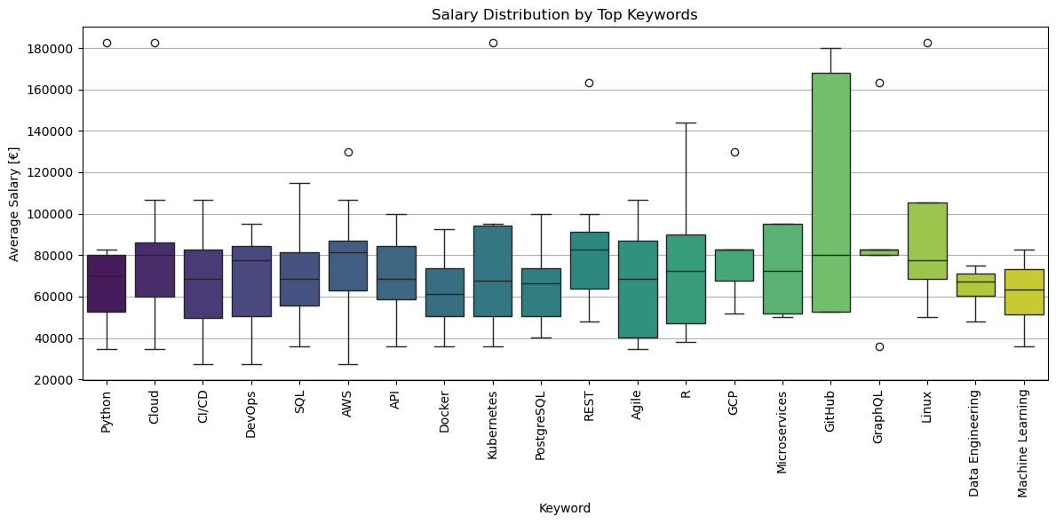
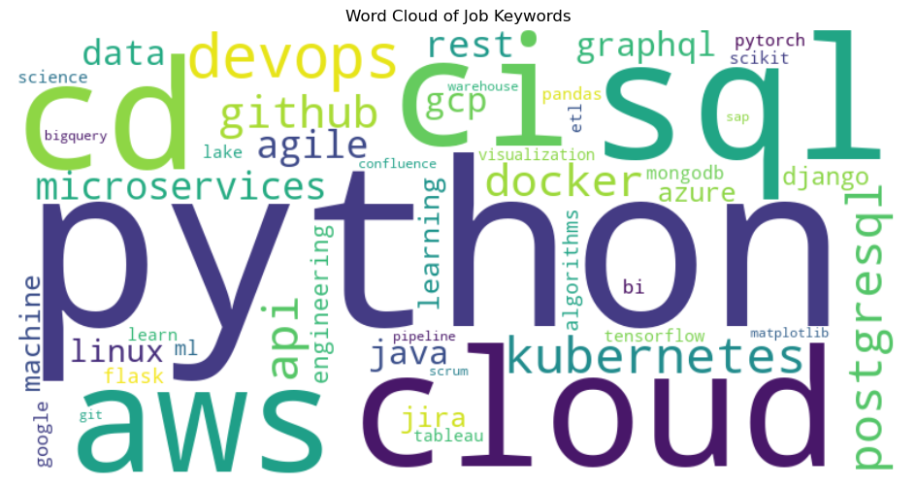
SAMPLE analysis

Slide 23
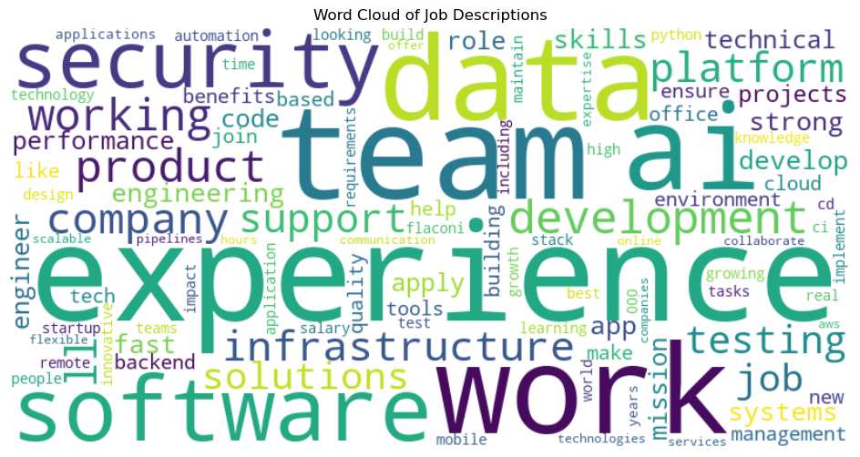
Thank you!

